Slide 1



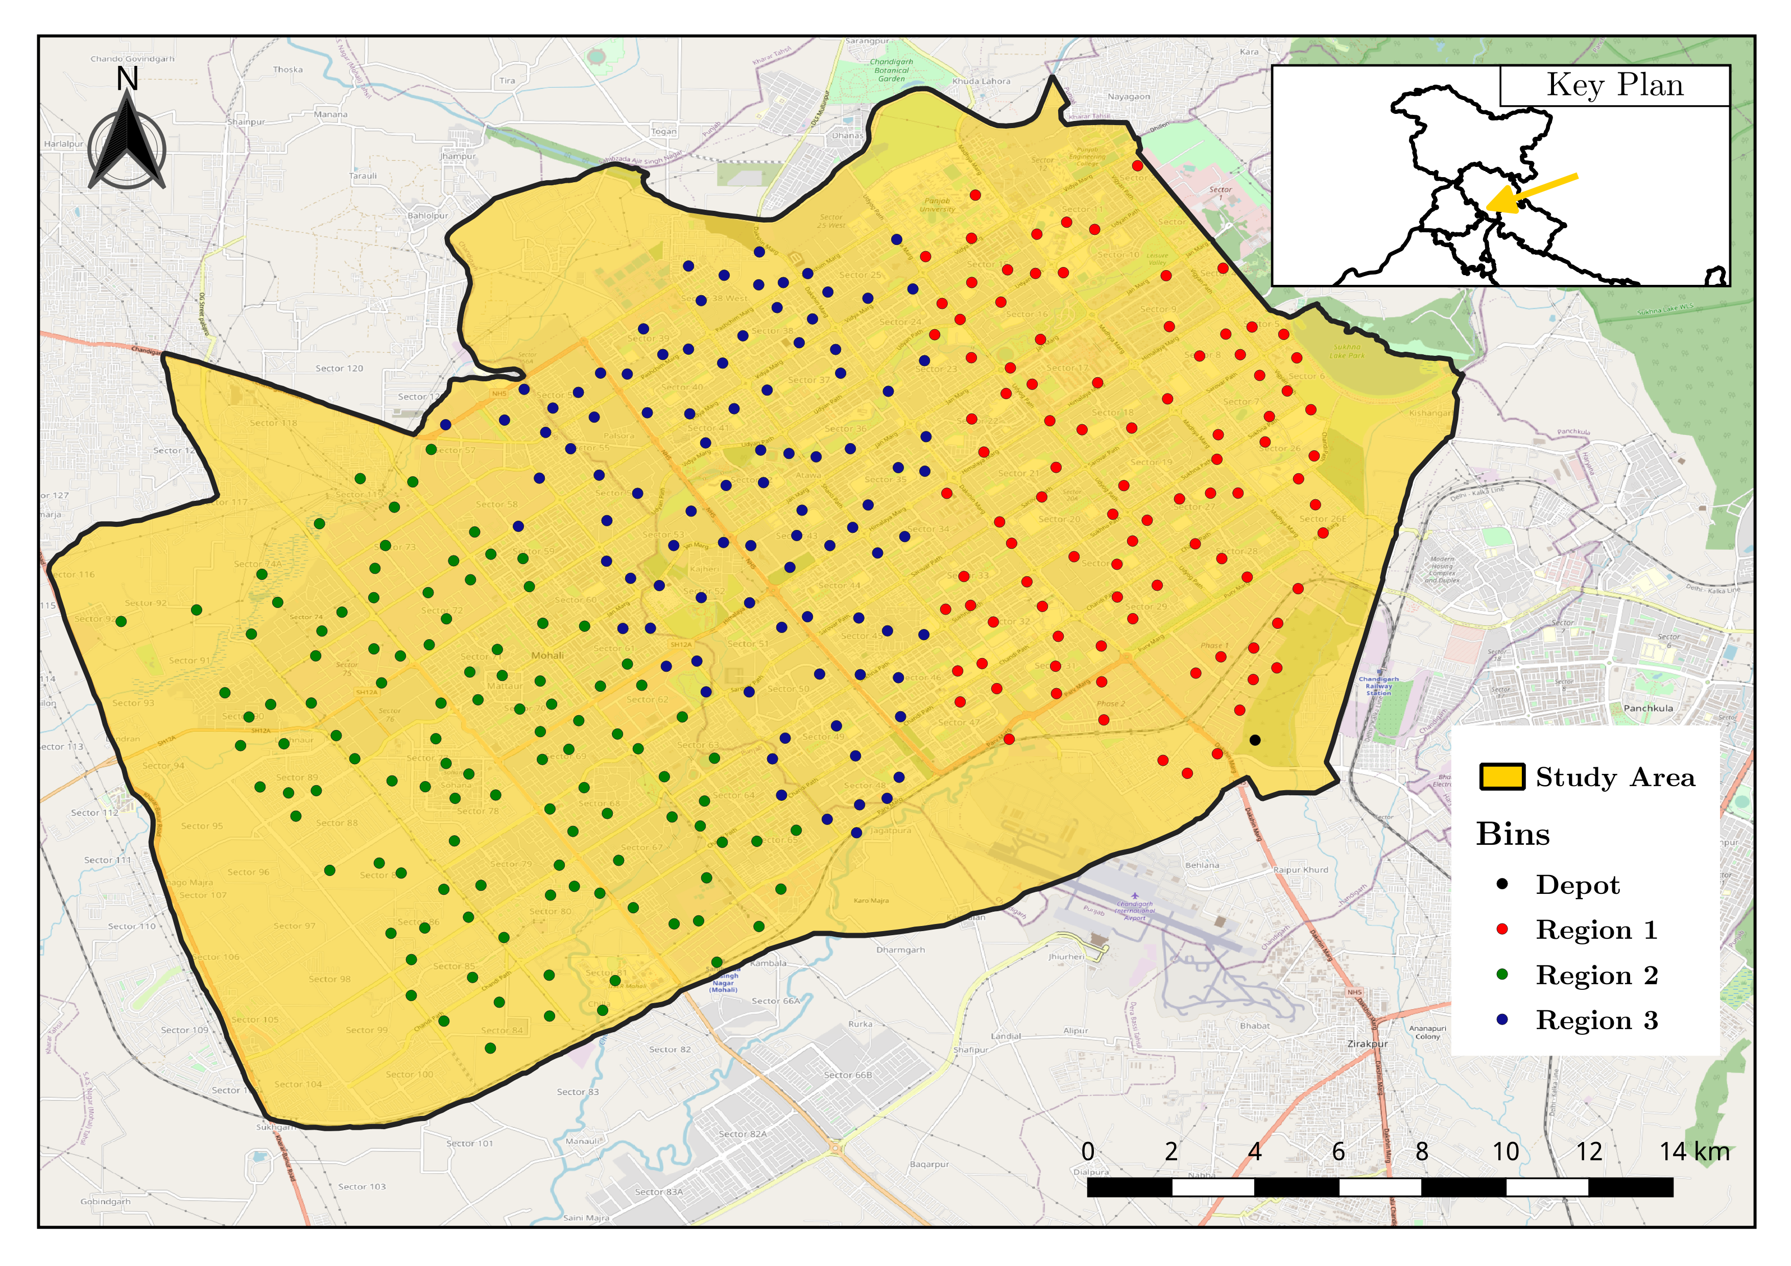
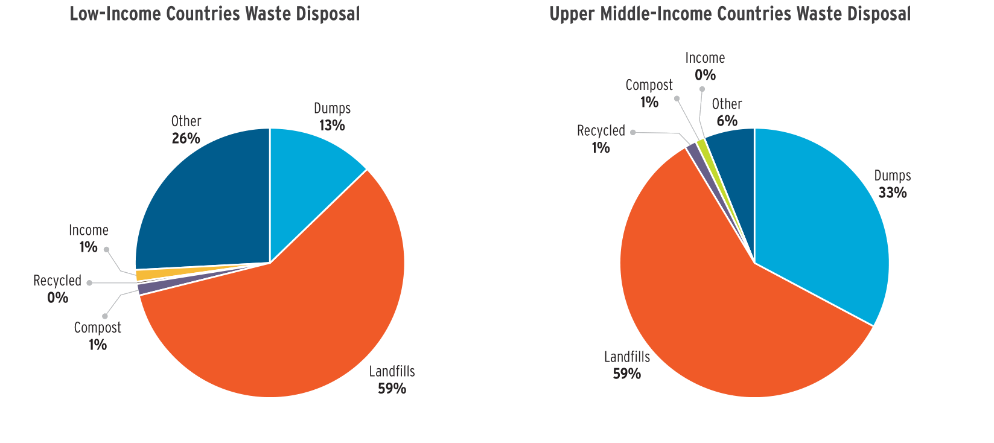
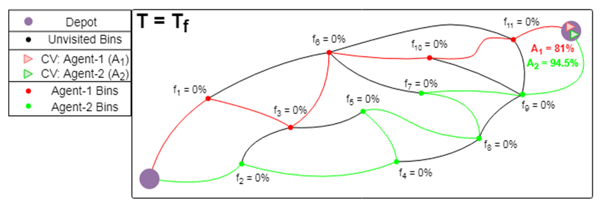
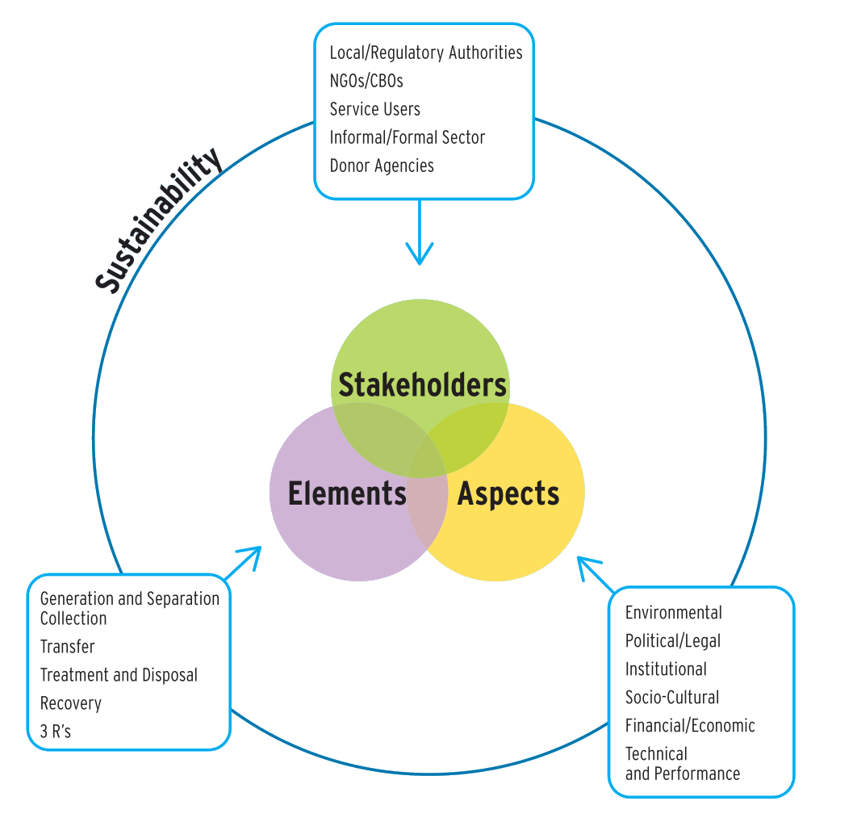
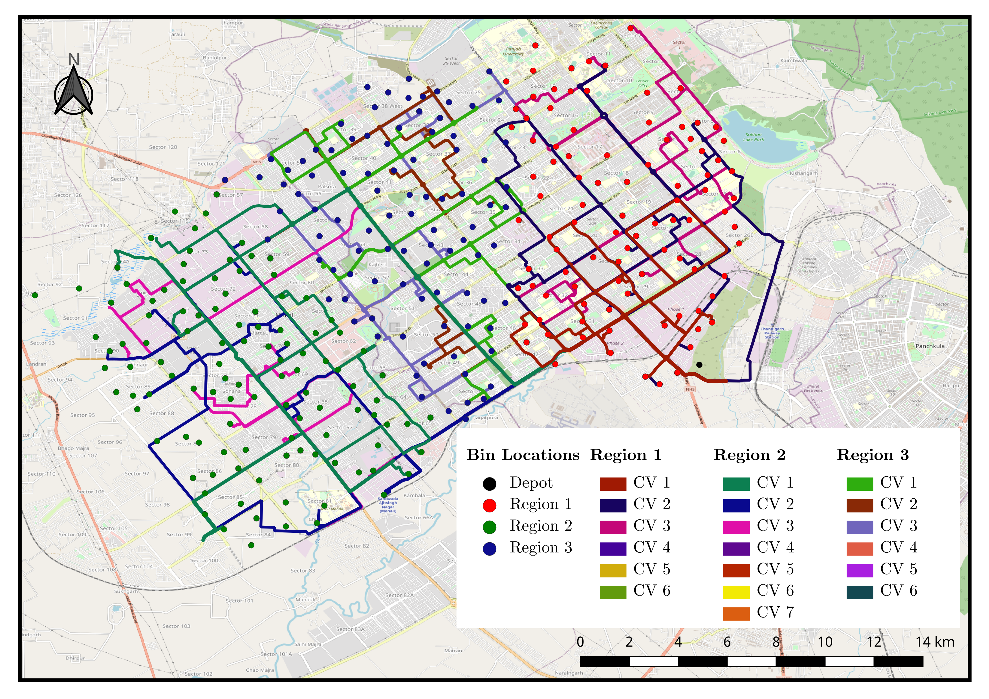
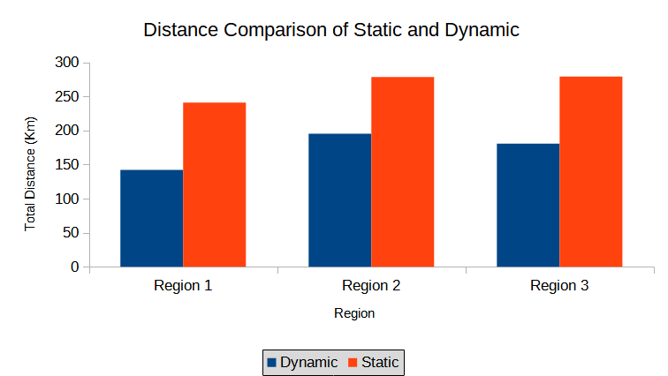
Dynamic Routing for Efficient Waste Collection in Resource
Constrained Societies
Marut Priyadarshi¹, Meet Maratha¹, Mohammad Anish², Vaibhav Kumar^{1*}
¹Department of Data Science and Engineering, Indian Institute of Science Education and Research Bhopal, India
²Department of Physics, Indian Institute of Science Education and Research Bhopal, India
Motivation
Methods
Solid Waste Management (SWM) is considered as one of the critical drivers of urban environmental management systems. India alone produces about 42.0 million tons of municipal solid waste annually, i.e., 1.15 lakh metric tons per day. Waste collection is the most integral activity of SWM. However, the waste collection in developing countries like India is very unorganized, primarily due to resource constraints and poor planning of available resources. While the amount of waste generated in developed countries is of a similar scale, the lack of proper treatment of generated waste in developing countries makes proper waste collection even more important. Our work focuses on providing an improvement over the currently used methods. A more efficient method would also decrease the operational cost of the process, which is another important consideration for a developing nation.
We generated the set of nodes for the city of Chandigarh using QGIS which represent the waste collection points that the CVs need to visit.
The nodes are then divided into 3 regions by using k-means clustering technique. These regions serve as stand ins for the actual municipal ward distributions.
The nodes were treated as Internet of Things (IoT) enabled smart bins which provided real time data about the level of waste they contained.
We formulated a multi-objective linear programming model for route calculation whose two objectives were to minimize distance traveled and maximize total waste collected.
The model was then solved using Gurobi optimizer for multiple execution cases with variables such as the number of CVs available.
The model was also solved for the scenario where the number of CVs were insufficient to satisfy the waste collection demands of the city. This case explored the resource constrained nature of waste collection for developing countries.
Research Objectives
Waste collection infrastructure consists of many interdependent parts and elements that allow it to function as one cohesive system. But these parts and, consequently, the system, has many points of failures and inefficiencies. These are even more severe for developing nations as they are generally resource constrained as well. Our work seeks to focus on some of the parts of the waste collection system and bring about improvements in them.
Our work aims to bring significant improvements to the performance of the systems currently in place by reducing the distance traveled by the Collection Vehicles (CVs) while also increasing the waste collected per distance.
While proposing the changes to the current system, we also had to keep the feasibility of its on-ground implementation by incorporating the resource availability for a location. This was to allow the stakeholders to have a larger number of options while making changes.
These changes, on a secondary level, would have a positive impact on the environment as well, due to the reduction of distance traveled. From a sanitary standpoint, efficient waste collection would also benefit public health by reducing exposed waste and the need for manual waste collection.
Results
We solved our model for the resource constrained scenario to obtain routes that served as the best compromise while satisfying our two objectives. We were able to distribute our insufficient resources to maximize waste collection while minimizing the distance traveled.
We extended the previous scenario to discover the minimum number of CVs which were able to fulfill the waste collection demands. In our case, the results came out to be 19 CVs. This enables stakeholders to accurately estimate the total cost of adequately servicing the entire city and it can also be applied to other locations.
We compared the currently implemented static waste collection system to our dynamic real-time model and observed that our model was able to collect the same amount of waste while reducing the total distance traveled by up to 45%
Future/Ongoing Work
One of the study’s limitations would be the non-consideration of a bin by any other CV, even if the bin were not full when visited. This can be addressed by relaxing the constraints, and its impact on outcomes can be examined. We have considered simulated smart bins for testing models, which can be replaced with IoT-enabled smart bins in real environments. Further integration of real-time data of accidents, street signage, construction work, etc., can provide more accurate routes.

